Slide 1
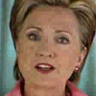
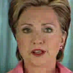
Belief Face: 1.0
Belief Face: 1.0
A
B
Belief Turned Right:
0.277
Belief Turned Right:
0.180

